Slide 1
Simulimpresa
Best practice

Slide 2
Simulimpresa
A simulation game mapped against EntreComp to teach entrepreneurial skills

Slide 3
SIMULIMPRESA
Practice started in October 1994, by the vocational training centre Istituto Don Calabria, in Ferrara, from Emilia-Romagna Region.
SIMULIMPRESA is a training project oriented at the administration, tourism and industrial fields using the simulation method.
The program promotes training through the experience acquired in a real environment (working hours, discipline, real working situations, tasks development).

Slide 4
SIMULIMPRESA
Teaches entrepreneurial competences through simulations of running an enterprise.
The participants may be:
unemployed
high-school or university students
young people with a low school attendance level
secondary school children,
workers in need of updating their vocational skills.
Notes:
in schools, vocational training centres, universities and companies

Slide 5
How schools can run enterprise simulations in their own institutions
Institutions make a classroom available to be furnished like a work environment.
Learners then work in ‘departments’ based on the blueprint of a company in their local area.

Slide 6
SIMULIMPRESA
Each learner rotates through every department to foster their skills in:
Administration Accountancy Computing Personnel management Marketing and sales Purchasing Entrepreneurship

Slide 7
SIMULIMPRESA
The teacher decides when a student moves to the next department based on the improvement of their skills.
As such, it may be that a student stays longer in one department than in another.
Students are also supported to behave as if they are in a real-life work environment.

Slide 8
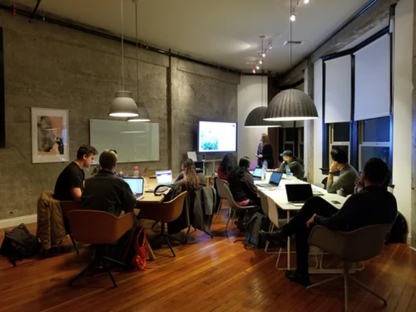
SIMULIMPRESA
The institutions involved applied EntreComp to focus on the entrepreneurship competences and skills they want to foster in their learners.
Differences between the approaches taken by the different organisations:
Generic education schools adopted competences in the Ideas & Opportunities and Resources competence areas
Technical schools tended to choose competences from the Resources and Into Action areas.
Notes:
in schools, vocational training centres, universities and companies

